Slide 1
Currency Converter
Created by team !yes (Vincent griest, ryan kovacs, forhaad miah)

Slide 2
Imagine This...
You are trying to plan a vacation, but don't know how expensive other countries are because they use a different currency
You want to find a country to visit with fun but affordable activities
You want to make sure you've saved up enough to cover costs

Slide 3
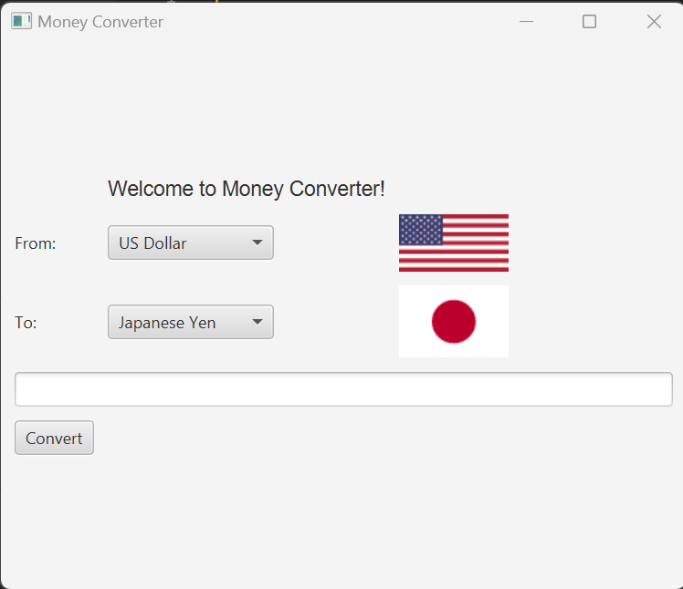
A Simple Solution
You can use our Money Converter to easily equate your countries' currency to another!

Slide 4
Contents
The Money Converter is made up of 3 main parts
Defining the conversions rates between currency metrics
Setting up the GUI for the converter
Using a method to convert classes

Slide 5
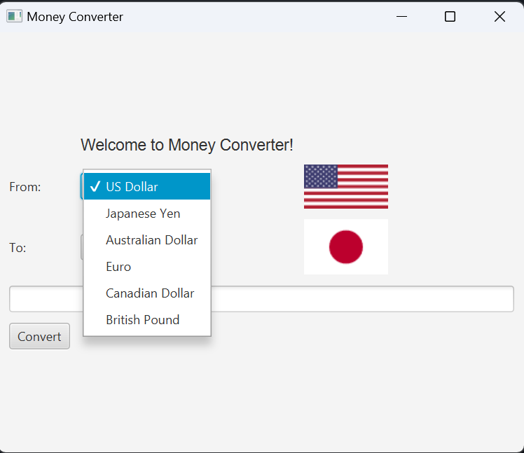
Defining Conversion Rates
What currencies did we use and why?

Slide 6
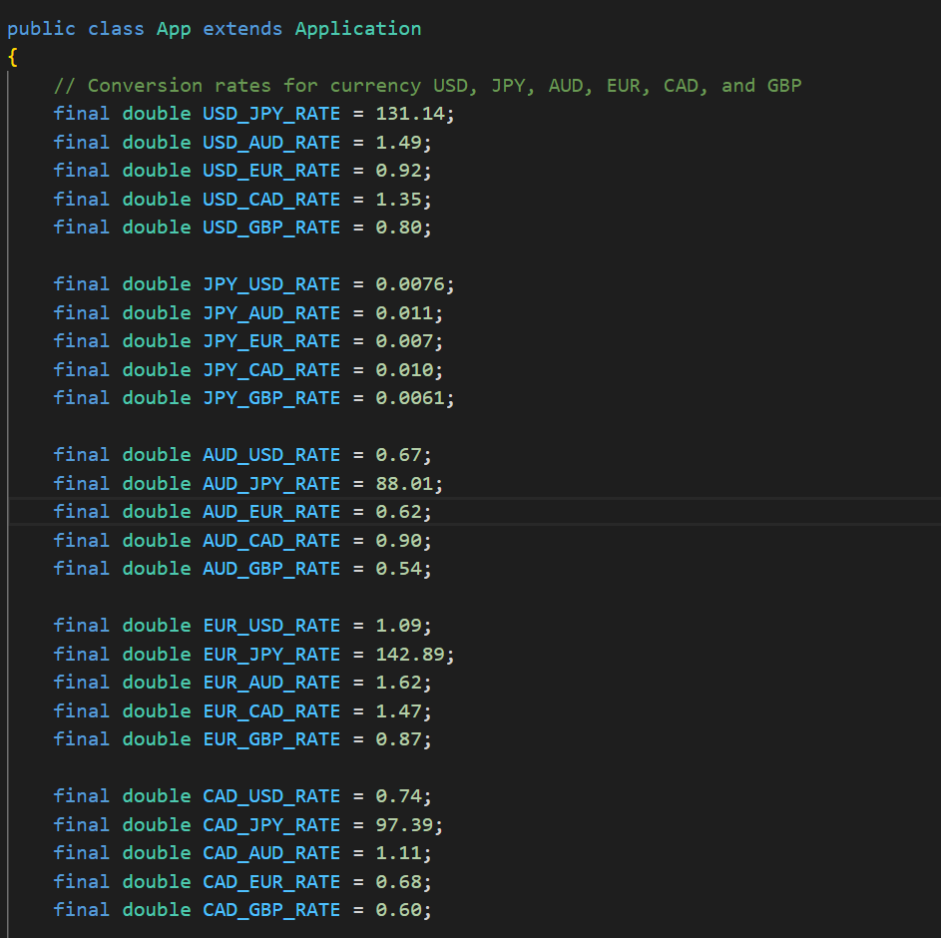
Defining Conversion Rates

Slide 7
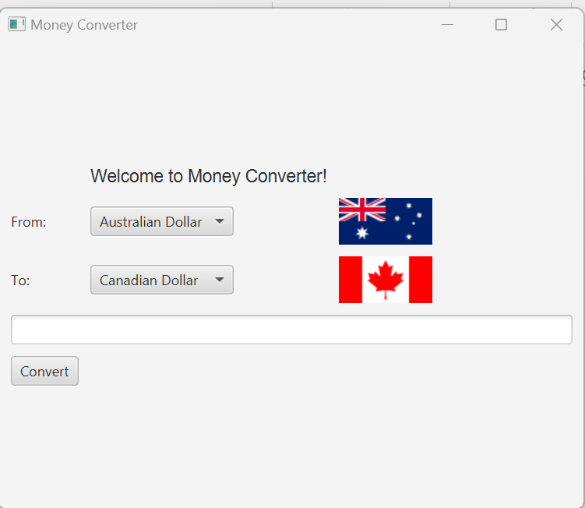
GUI Setup
We wanted to set up choice boxes and a grid pane layout to make the converter simple to use. We also added flag images to each currency type to make the application more visually appealing.

Slide 8
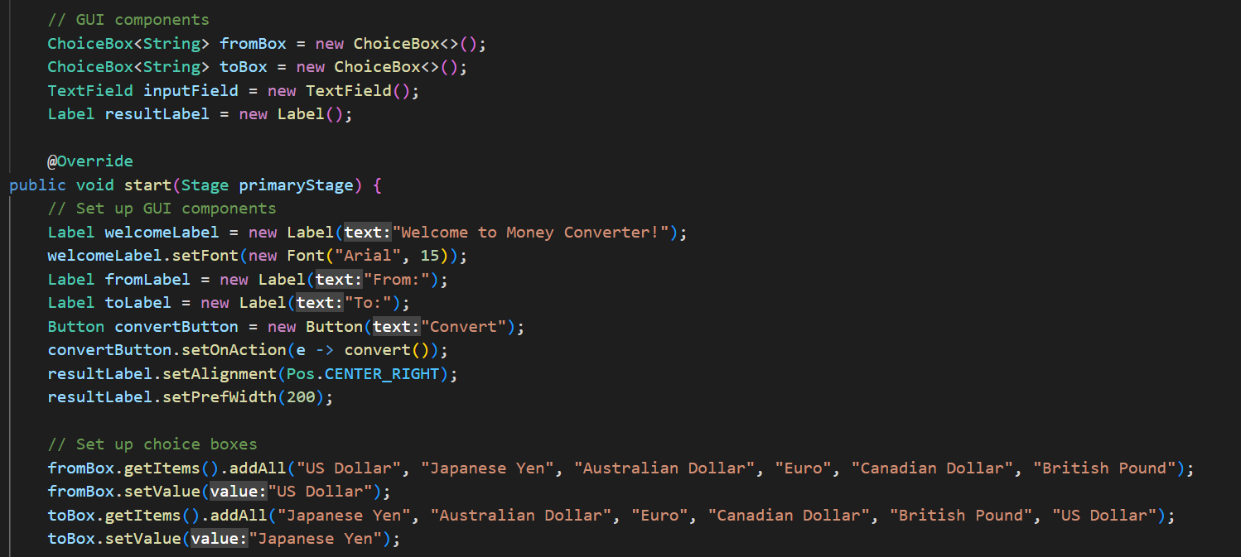
GUI Setup

Slide 9
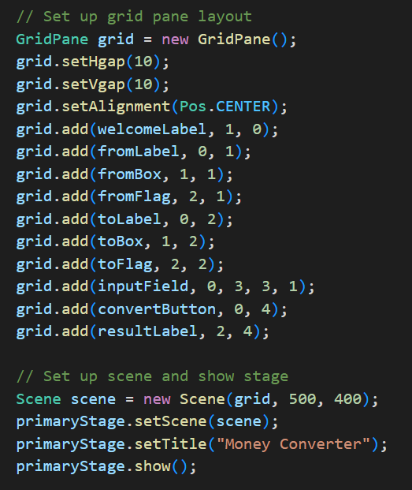
GUI Setup

Slide 10
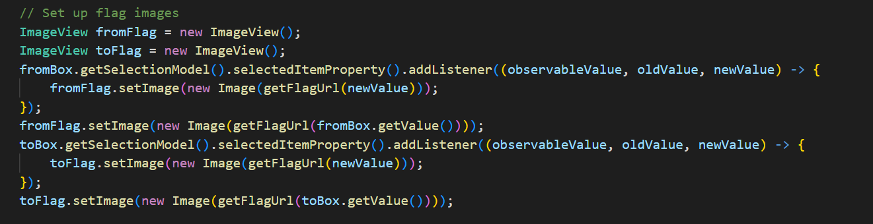
GUI Setup

Slide 11
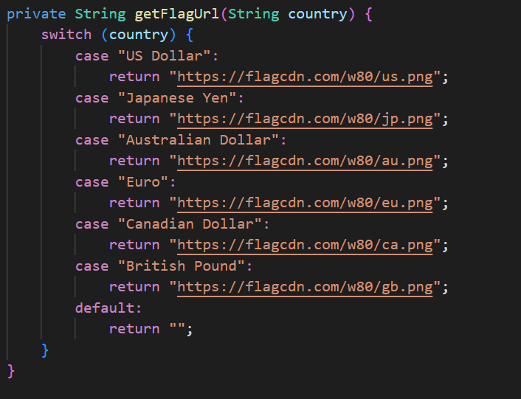
GUI Setup

Slide 12
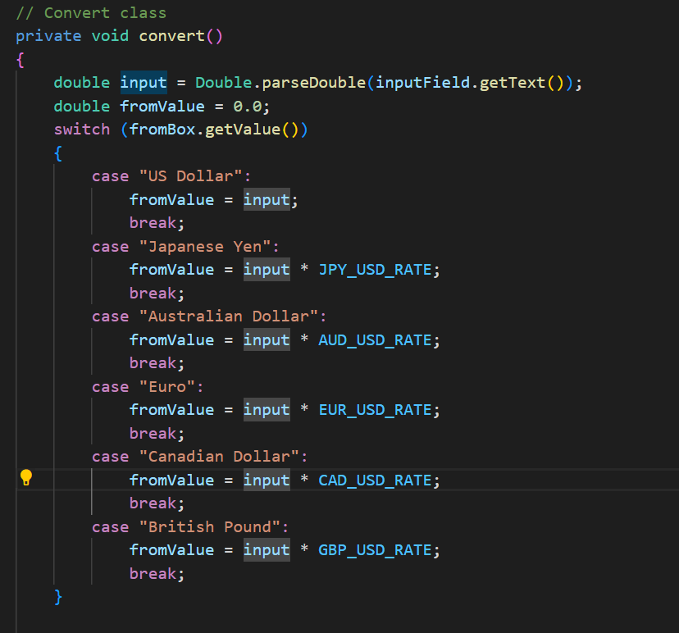
Implementing Conversion
The conversion was implemented using a method with many switch/break cases to carry out the requested conversion

Slide 13
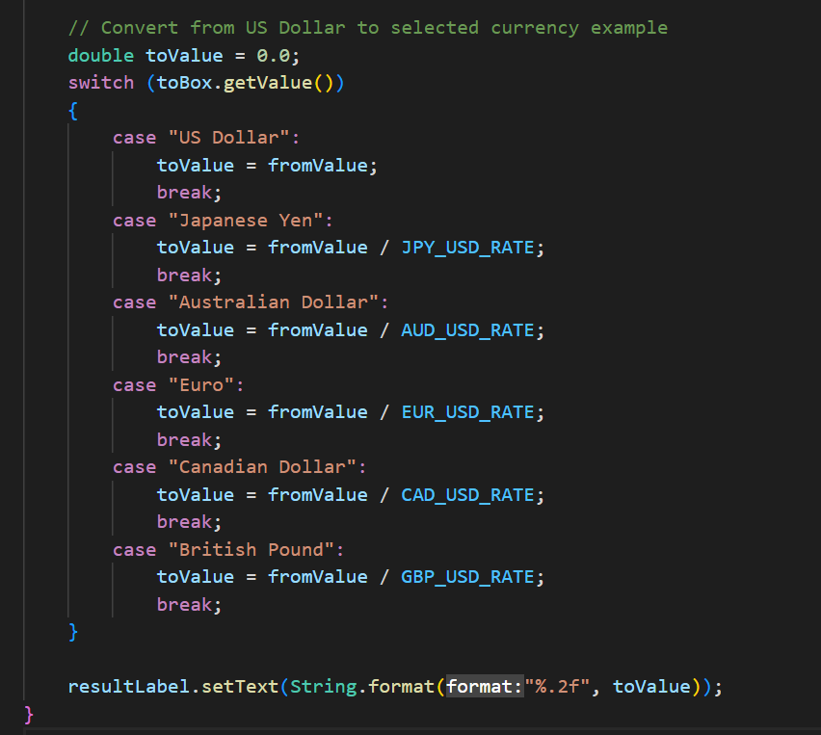
Implementing Conversion

Slide 14
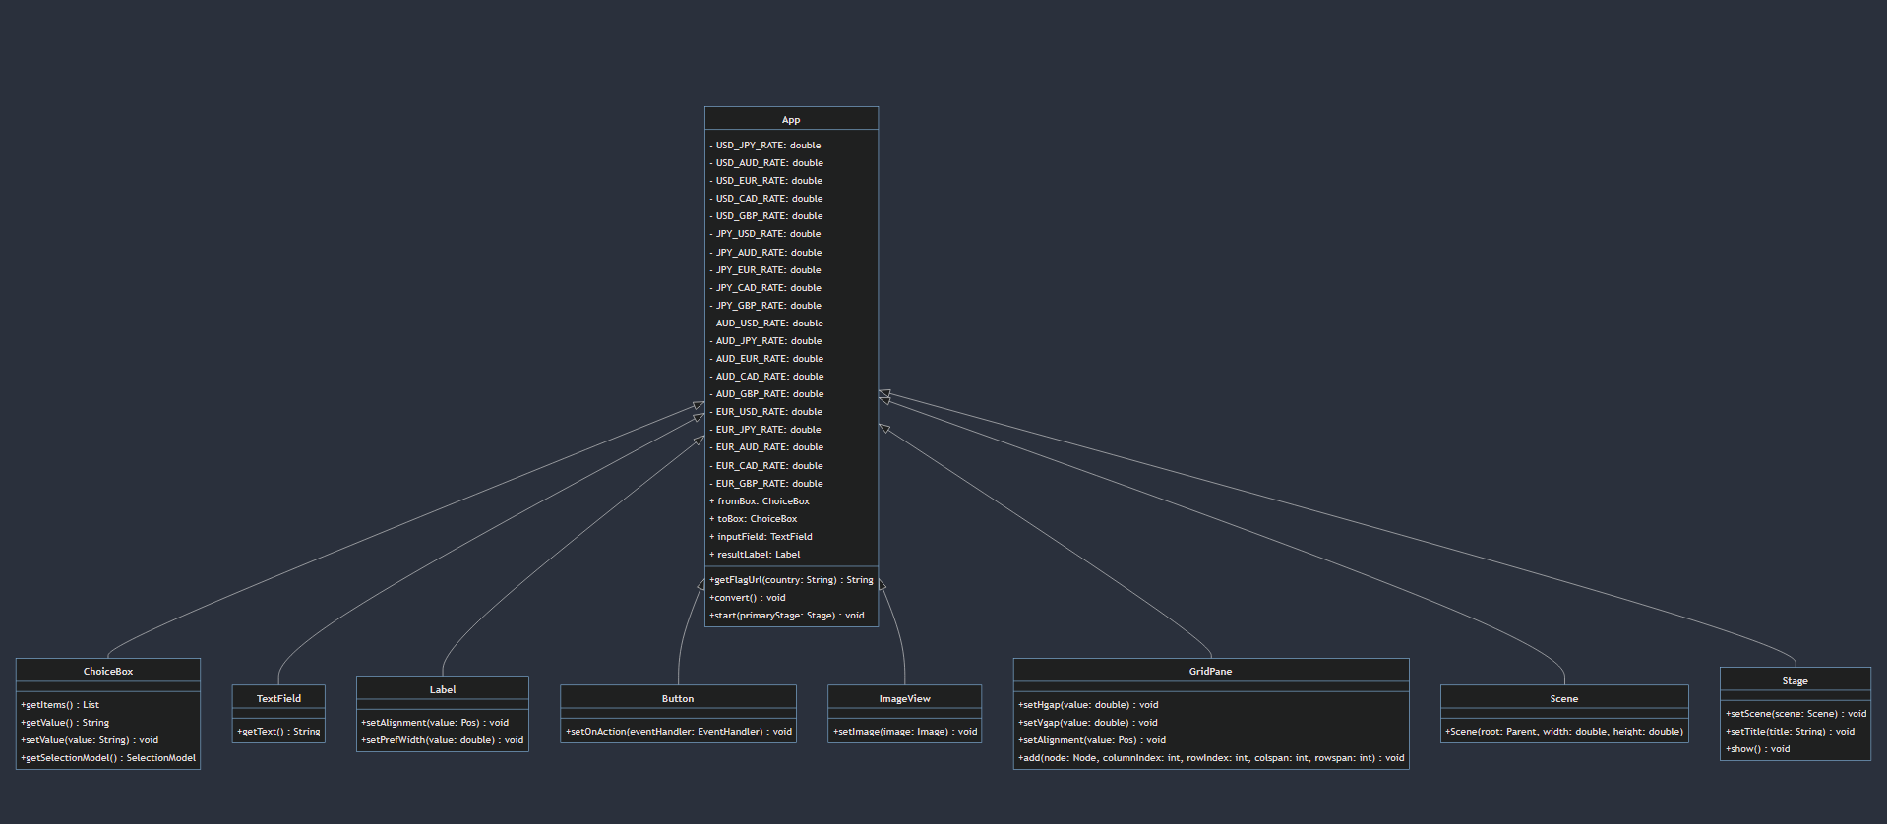
UML Diagram

Slide 15
Summary of UML Diagram
App holds ChoiceBox, TextField, Label, Button, ImageView, GridPane, Scene and Stage

Slide 16
What We Have Learned
How to effectively use switch/break cases
GUI is time consuming to set up, but is extremely useful
How to use Java to solve a problem in an effective way

Slide 17
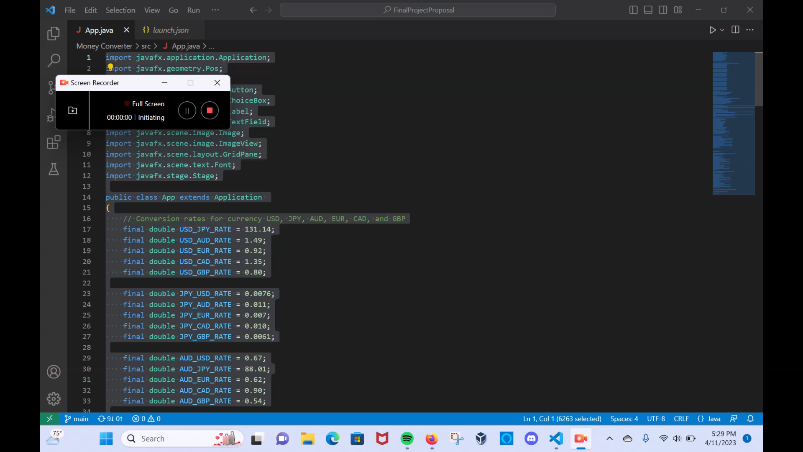
Demo!
(insert Demo Link here)

